Slide 1
Inter Process Communication
Session 13

Slide 2
Agenda
Synchronization with semaphores
Shared memory concepts and Implementation
Message queues

Slide 3
IPC - interprocess communication API
Need of IPC
Controlling IPC
Three main services in IPC
Shared memory
Message queue
Semaphores
1,2 are used for sharing information between processes
3 is for synchronizing the critical concurrent activities

Slide 4
IPC API’s
How to generate unique communication structure between two processes
How process involved in communication will use that unique structure
key
Used to generate one unique id
One process will use key to generate unique id and other will use to
obtain the unique id
id
Used as an identifier for the next communication

Slide 5
Shared memory
Sharing allows data transfer between process
Shared memory is recommended for sharing large data
How shared memory is attached to process address space
Permissions of shared memory
Size of shared memory
Identifier for shared memory

Slide 6
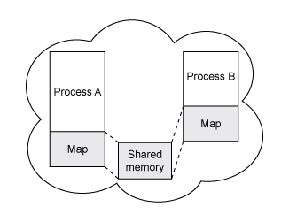
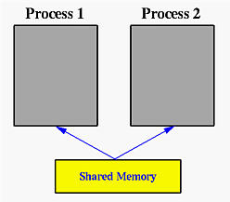
Shared memory
Brief view Mapping of shared memory

Slide 7
Shared memory API
3 main inputs to create a shared memory
key - identifier of shared memory region
size - size of the shared memory in bytes
flags - dictate the permission of newly created shared memory
shmget function to create shared memory segment id or to get it
int shmget(int key, int size, int flags)
return value - shared memory segment id
This function is used for 2 purposes :
to create shared memory region
to get shared memory segment id of existing shared memory region

Slide 8
Shared memory API
controlling access to shared memory
int shmctl(int shmid, int cmd, struct shmid_ds *buf);
shmid - refers to shared memory segment id obtained in call to shmget
cmd may refer to one of the following values
SHM_LOCk - used for locking shared memory
SHM_UNLOCK - used for unlocking shared memory
IPC_STAT - used for obtaining control information of the shared memory
IPC_SET - set effective user and group id and access permissions
IPC_RMID - remove shared memory region
Third argument is used for holding results
The caller needs to have proper permission and effective shmid of owner, creator or superuser to call shmctl on shared memory region identified by shmid

Slide 9
Shared Memory API
Attaching shared memory region
void *shmat(int shmid, const void *shmaddr, int shmflg)
If successful it will return pointer to the shared memory and -1 on failure
e.g.
char * shared_memory = (char *) shmat(shmid, NULL, 0)
if ( shared_memory == (char *) -1 )
print failure
else
print success and go ahead with shared_memory to write or read data to or
from shared memory
Detaching shared memory region
int shmdt(const void *shmaddr)
If successful then detach shared memory region pointed by shmaddr from
process address space and returns 0 else -1

Slide 10
Shared memory example (creator and accessor)
shm_server.c
Create shared memory region using call to shmget with read write
permission to all (user, group and others)
Attach that shared memory region to its address space
Write something and wait to get read response from client
Detach shared memory from the address space
Remove shared memory region using call to shmctl
shm_client.c
Get shared memory id using call to shmget with key as used in server.
Attach that shared memory region to its address space
Read from shared memory and write some value for which server is waiting
Detach shared memory from the address space
Remove shared memory region using call to shmctl

Slide 11
Synchronization
Concurrency
race conditions
Why we need synchronization
Examples
1. Banking example credit and debit
2. File read and write
3. Ticket booking

Slide 12
Semaphores
Process vs Thread level synchronization
Named semaphore vs unnamed semaphore
Semaphores in shared memory
Count of semaphore

Slide 13
POSIX Semaphore
Semaphore count
SEM_VALUE_MAX
Semaphore structure
sem_t
Functions

Slide 14
named semaphores
Opening named semaphore
sem_t *sem_open(const char *name, int oflag)
sem_t *sem_open(const char *name, int oflag,
mode_t mode, unsigned int value)
first variant is used to access to already opened semaphore
second variant is used to open a named semaphore and initialize it with
some initial value.
Name specifies name of file. it should start from /
oflag specifies flags to be used while opening semaphore
O_CREAT - flag value is used for creating semaphore for the first time
0 - is used in first variant of sem_open function
On success sem_open returns address of new semaphore and on failure returns
SEM_FAILED
return value of sem_open should be checked/compared against SEM_FAILED
Closing named semaphore
int sem_close(sem_t *sem)
On success 0 is returned and on failure -1 is returned

Slide 15
Initialization and destruction of semaphores (unnamed)
Initialization
int sem_init (sem_t *sem, int pshared, unsigned int value)
semaphore structure variable sem is initialized with given value.
This will signify count
pshared - defines whether semaphore can be shared between processes
or not
Return value :
On initialization is successful return 0 else -1
reason for failure
value exceeds the maximum counter value SEM_VALUE_MAX
This semaphore can not be shared and pshared value is specified as other than 0
Destruction
int sem_destroy (sem_t * sem)
Destroys semaphore structure sem, Fails if any thread or process is waiting on
semaphore

Slide 16
Waiting on and signalling semaphore ( for named and unnamed)
Signalling
int sem_post(sem_t *sem)
increases count of sem by 1 in case of success and returns 0
This will cause one of the process waiting on sem to woke up
In case of failure returns -1 and count value is unchanged
Waiting
int sem_wait(sem_t *sem)
int sem_trywait(sem_t *sem)
int sem_timedwait(sem_t *sem, const struct timespec *abs_timeout)
First variant decrements the count in sem blocks calling process if count before increment in sem is 0.
sem_trywait - Same as sem_wait except instead of blocking returns an error
sem_timedwait - same as sem_wait except it get blocked for time specified in abs_timout struct

Slide 17
Sharing semaphore between processes
Sharing of unnamed semaphores between processes requires support of shared memory
semaphore variables can be stored in shared memory and can be accessed
by processes using these semaphores to synchronize their tasks
Named semaphores can access semaphores by using same name in sem_open

Slide 18
Message queue
Recommended for sending small messages between processes
Implemented as a queue
Unique message queue id is generated from a key
This unique message queue id is used in further communication
Message is written from one and read from the other, each message has a type
Has limit on what amount of message can be sent without reading
Blocking vs non blocking

Slide 19
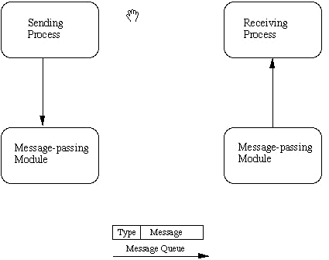
Message queue

Slide 20
message queue API
Message queue structure
struct queue {
long type; // Determines unique type of message > 0
char buf[1] // Actual message
} q;
Getting message queue id from key or create message queue id from key
int msgget(key_t key, int msgflg)
-- key to create a message queue with given key or to retrieve a message
queue if of already created message queue
-- msgflg determines creation and permissions of message queue
IPC_CREAT - to create message queue
-- returns message queue id if successful else -1

Slide 21
Message queue API
Sending message (calling process must have write permission on queue)
int msgsnd(int msqid, const void *msgp, size_t msgsz, int msgflg)
receiving message (calling process must have read permission on queue)
ssize_t msgrcv(int msqid, void *msgp, size_t msgsz, long msgtyp,
int msgflg);
-- msqid message queue id returned by call to msgget
-- msgp message queue structure
-- msgsz size of message data in message queue except message type
-- msgflg - used for performing blocking or non blocking write/write
on failure both msgsnd and msgrcv returns -1 and on success msgsnd returns 0 and msgrcv returns number of bytes actually returned to the message queue

